Slide 1
IBM Capstone Project - The Battle of Neighborhoods
Safest Neighborhood for opening of commercial establishments Vancouver.

Slide 2
Index
Introduction: Business Problem
Data
Data Analysis
Importing Libraries
Methodology
Results and Discussion
Conclusion

Slide 3
Introduction: Business Problem
The aim of this project is to find a safe and secure location for opening of commercial establishments in Vancouver, Canada. Specifically, this report will be targeted to stakeholders interested in opening any business place like Grocery Store in Vancouver City, Canada.
The first task would be to choose the safest borough by analysing crime data for opening a grocery store and short listing a neighbourhood, where grocery stores are not amongst the most commom venues, and yet as close to the city as possible.
We will make use of our data science tools to analyse data and focus on the safest borough and explore its neighborhoods and the 10 most common venues in each neighborhood so that the best neighborhood where grocery store is not amongst the most common venue can be selected.

Slide 4
Data
Based on definition of our problem, factors that will influence our decission are:
finding the safest borough based on crime statistics
finding the most common venues
choosing the right neighbourhood within the borough
We will be using the geographical coordinates of Vancouver to plot neighbourhoods in a borough that is safe and in the city's vicinity, and finally cluster our neighborhoods and present our findings.

Slide 5
Data
Part 1:
Using a real world data the Vancouver Crimes from 2003 to 2019: A dataset consisting of the crime statistics of each Neighbourhoof in Vancouver along with type of crime, recorded year, month and hour.
Part 2:
Gathering additional information of the list of officially categorized boroughs in Vancouver from Wikipedia.: Borough information will be used to map the existing data where each neighbourhood can be assigned with the right borough.

Slide 6
Data
Part 3:
Creating a new consolidated dataset of the Neighborhoods, along with their boroughs, crime data and the respective Neighbourhood's co-ordinates.: This data will be fetched using OpenCage Geocoder to find the safest borough and explore the neighbourhood by plotting it on maps using Folium and perform exploratory data analysis.
Part 4:
Creating a new consolidated dataset of the Neighborhoods, boroughs, and the most common venues and the respective Neighbourhood along with co-ordinates.: This data will be fetched using Four Square API to explore the neighbourhood venues and to apply machine learning algorithm to cluster the neighbourhoods and present the findings by plotting it on maps using Folium.

Slide 7
Vancouver Crimes Dataset Description
Part 1:
Using a real world data set from Kaggle containing the Vancouver Crimes from 2003 to 2019
Vancouver Crime Report
Properties of the Crime Report
TYPE - Crime type
YEAR - Recorded year
MONTH - Recorded month
DAY - Recorded day
HOUR - Recorded hour
MINUTE - Recorded minute
HUNDRED_BLOCK - Recorded block
NEIGHBOURHOOD - Recorded neighborhood
X - GPS longtitude
Y - GPS latitude
Data set URL: GitHub link

Slide 8
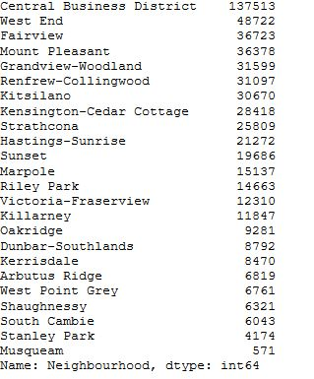
Vancouver Crime Report
By Dropping (MINUTE', 'HUNDRED_BLOCK', 'X', 'Y‘) Columns
And focusing On ('Type', 'Year','Month','Day','Hour','Neighbourhood‘) Columns
Getting the Count Values For Crimes

Slide 9
Data Analysis
Part 2:
Gathering additional information about the Neighborhood from Wikipedia
As part of data set Borough which the neighborhood was part of was not categorized, so we will create a dictionary of Neighborhood and based on data in the following Wikipedia page.

Slide 10
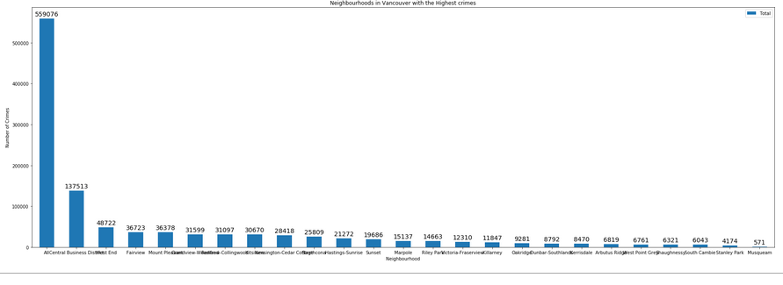
Neighborhoods with highest crime

Slide 11
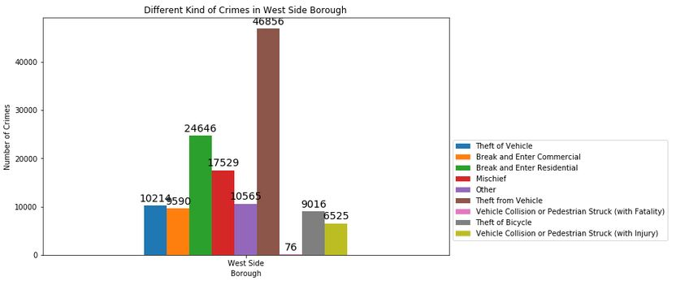
Different Kind of Crimes in West Side Borough
By taking West Side as an example:
Can get the Different Kind of Crimes In this Borough

Slide 12
Data Analysis
Part 3:
Creating a new consolidated dataset of the Neighborhoods, along with their boroughs, crime data and the respective Neighbourhood's co-ordinates.:
This data will be fetched using OpenCage Geocoder to find the safest borough and explore the neighbourhood by plotting it on maps using Folium and perform exploratory data analysis.

Slide 13
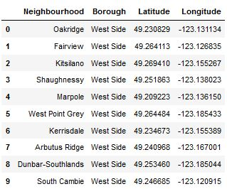
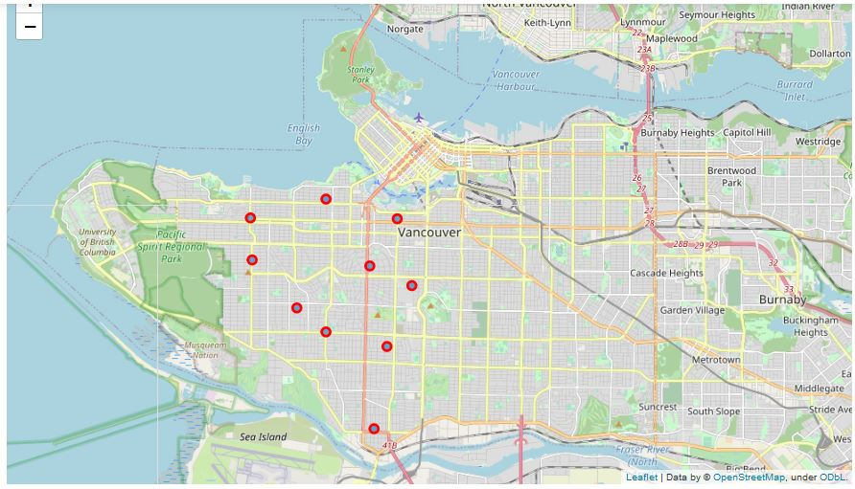
fetched Longitude, latitude OpenCage Geocoder
By fetching long, lat tuide of West Side Neighbourhood and Map them

Slide 14
Data Analysis
Part 4:
Creating a new consolidated dataset of the Neighborhoods, boroughs, and the most common venues and the respective Neighbourhood along with co-ordinates.:
This data will be fetched using Four Square API to explore the neighbourhood venues and to apply machine learning algorithm to cluster the neighbourhoods and present the findings by plotting it on maps using Folium.

Slide 15
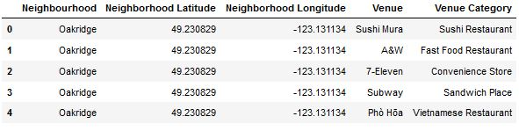
the most common venues and the respective Neighbourhood

Slide 16
Importing Libraries
numpy
pandas
opencage
matplotlib
folium
requests
pandas.io
sklearn

Slide 17
Methodology
Categorized the methodologysection into two parts:
Exploratory Data Analysis: Visualise the crime repots in different Vancouver boroughs to idenity the safest borough and normalise the neighborhoods of that borough. We will Use the resulting data and find 10 most common venues in each neighborhood.
Modelling: To help stakeholders choose the right neighborhood within a borough we will be clustering similar neighborhoods using K - means clustering which is a form of unsupervised machine learning algorithm that clusters data based on predefined cluster size. We will use K-Means clustering to address this problem so as to group data based on existing venues which will help in the decision making process.

Slide 18
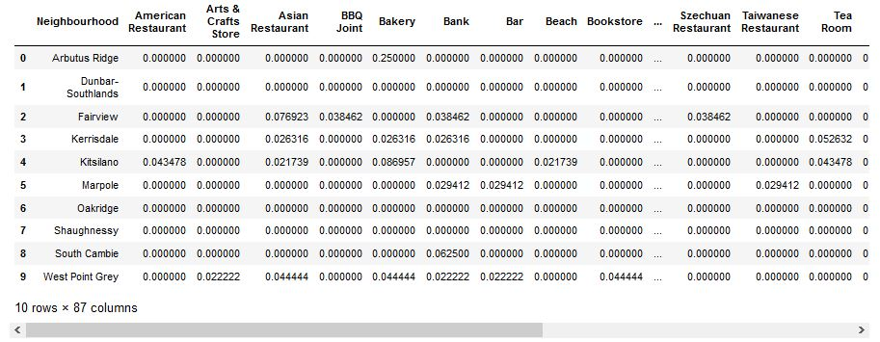
One Hot Encoding to Analyze Each Neighborhood

Slide 19
Results and Discussion
The objective of the business problem was to help stakeholders identify one of the safest borough in Vancouver, and an appropriate neighborhood within the borough to set up a commercial establishment especially a Grocery store. This has been achieved by first making use of Vancouver crime data to identify a safe borugh with considerable number of neighborhood for any business to be viable. After selecting the borough it was imperative to choose the right neighborhood where grocery shops were not among venues in a close proximity to each other. We achieved this by grouping the neighborhoods into clusters to assist the stakeholders by providing them with relavent data about venues and safety of a given neighborhood.

Slide 20
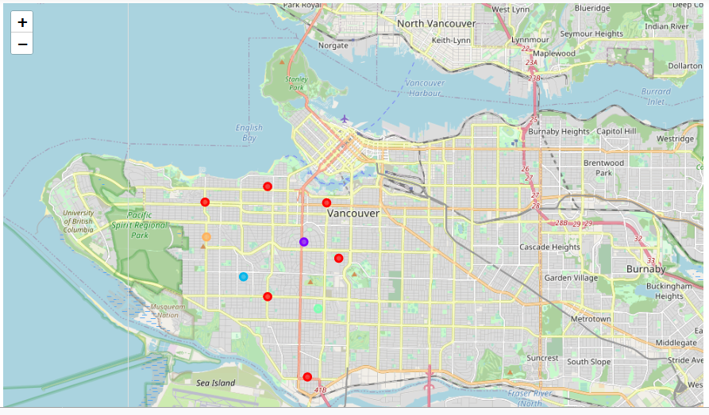
5 Cluster of safety in West Side Borough
Where Each Color Represent A cluster

Slide 21
Conclusion
explored the crime data to understand different types of crimes in all neighborhoods of Vancouver and later categorized them into different boroughs, this helped us group the neighborhoods into boroughs and choose the safest borough first. Once we confirmed the borough the number of neighborhoods for consideration also comes down, we further shortlist the neighborhoods based on the common venues, to choose a neighborhood which best suits the business problem.

